Slide 1
Analysis of TripAdvisor Reviews
Nidhi Danayak

Slide 2
Agenda
Agenda
Introduction
Impact of TripAdvisor Reviews
Problems and Challenges
Problem Statement
Methodology
Exploratory Analysis
Knime Overview
Python Overview
Performance
Outcome
Lessons Learned
Questions

Slide 3
Introduction
The digital age has made it easier for the consumer to be more intelligent with his or her decisions when it comes to travel
Hotels must understand the needs of the consumer in order to differentiate between peers
Using a collection of 20,000 hotel reviews from TripAdvisor, we determined what amenities generate the most reviews
Our aim is to separate the positive and negative reviews into frequent n-grams to understand what hotel features and amenities are most likely to result in either a positive or negative review.

Slide 4
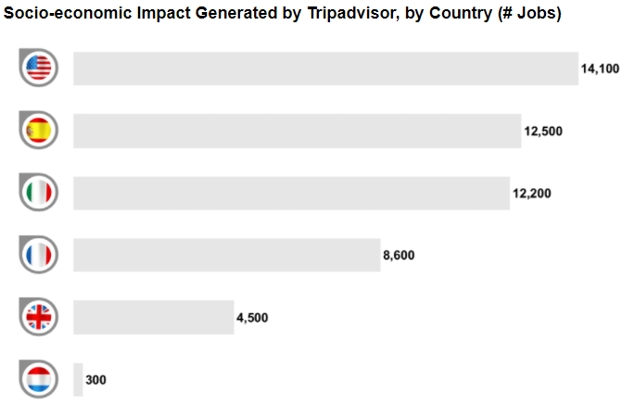
Impact of TripAdvisor Reviews
95% of travelers use reviews prior to making a booking decision
If prices are equal, a hotel with a higher review is 3.9 times more likely to receive a customer’s business
76% of traveler’s are willing to pay more for a hotel with a higher rating
A one-star increase in rating typically leads to a 5-9% increase in revenue
Reviews and scores have been correlated to $546 billion in global tourism in a given calendar year

Slide 5
Problem and Challenges
Data is currently in CSV format
Data is unstructured text data
Data will need to be properly pre-processed for text mining algorithm
Data is negatively skewed
Python code/Knime workflow must be optimized to reduce processing power required

Slide 6
Problem Statement
Assess the biggest factors in determining if a hotel receives positive or negative reviews.
Acquire a data dump of over twenty thousand reviews from Kaggle.com, and will use Python and Knime to analyze the data.
Perform sentiment analysis on all the available reviews to understand the major keywords used by the customer while rating a hotel positive or negative.
Separate these positive and, negative reviews into frequent n-grams to understand what hotel features and amenities are most likely to result in either a positive or negative review.

Slide 7
Methodology
Data Collection
Download data from Kaggle.com
Data Preprocessing
Methodology
Put data in uniform format and remove unnecessary words and phrases
Frequent n-grams and perform sentiment analysis
Results
Text Mining
Process the data and tokenize the documents
Extract most frequently occurring n-grams to derive results

Slide 8
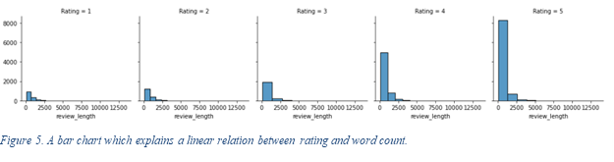
Exploratory Data

Slide 9
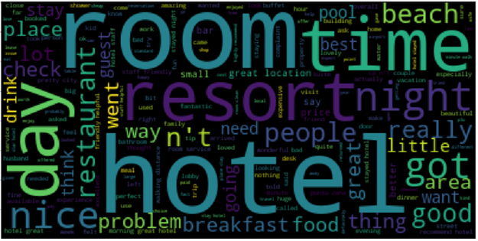
Exploratory Data (cont.)

Slide 10
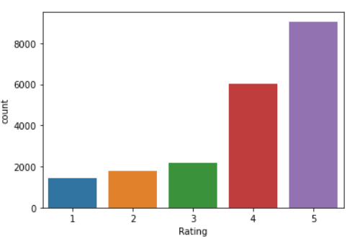
Exploratory Data (cont.)

Slide 11
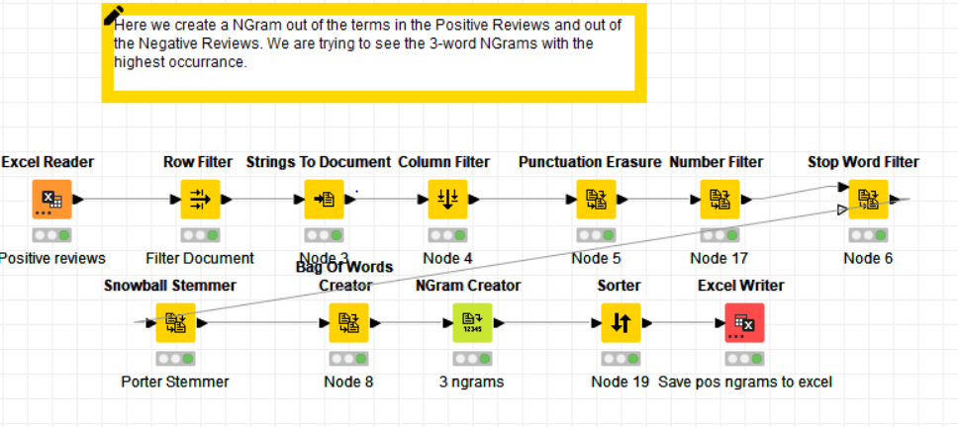
Knime Overview
Negative Word Cloud

Slide 12
Positive Reviews: Highest Occurring trigrams
Theme | Top Words | Corpus Frequencies (highest 81363—lowest 94) | Sample Review
Friendly Staff | staff friendli help, hotel staff friendli, staff help friendli staff extrem friendly | 81363, 27251, 22321, 14303 | Thoroughly enjoyed our stay in Monaco, room comfortable lovely amenities friendly staff. Will definitely come back
Location | Hotel great locat, easi walk distanc, minut walk awai, minut walk hotel | 51960 27146 26690 18940 | great hotel, good sized clean rooms, helpful staff, unbeatable location, walk door pikes market original Starbucks
Amenities | King size bed Flat screen tv Free internet access bed extrem comfort | 53878 44782 27048 14070 | super clean room immaculate bathroom, big king bed flat screen plasma note tv guest services
Room | Room good size room spaciou clean room clean comfort | 20618 16749 17758 | rooms clean and roomy not mention vibe French quarter

Slide 13
Negative Reviews: Highest Occurring trigrams
Theme | Top Words | Corpus Frequencies (highest 30058—lowest 11) | Sample Review
Mechanical issues/inconveniences | Did not work room not readi did nt work No hot water No air condit did not lock phone did not | 30058 15022 19814 9149 7722 4286 3926 | room basic, nothing excited, things thermostat did not work unable shut air conditioning.the day checking called manager requested refund, listening problems encoutered
Dirty | room not clean Dirti did nt Dirti unaccommod hotel Room pathet dirti | 8310 1180 1032 1032 | tiny rooms toilet/shower unit room rooms smell like sewer hallways smell like raid
Service | Staff did not Servic did not Call desk told | 5662 4392 3892 | rude desk manager place ridiculous, 89.99 hotel smells old dirt customer service rude
Communication | Did not speak Spoke little English Did nt understand Not speak spanish | 4228 3336 3136 2992 | room service useless did not speak english worst room filthy floors looked like n't mopped months

Slide 14
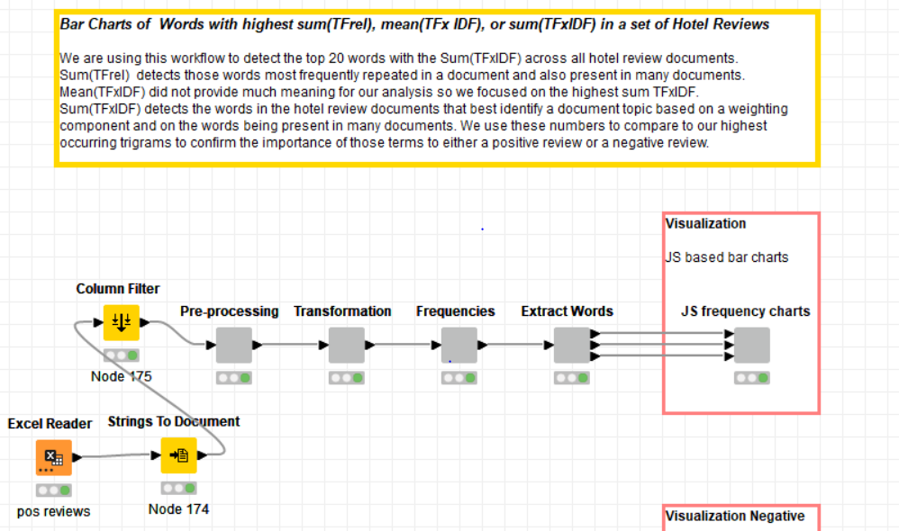
Knime TF-IDF Visualziation Worflow

Slide 15
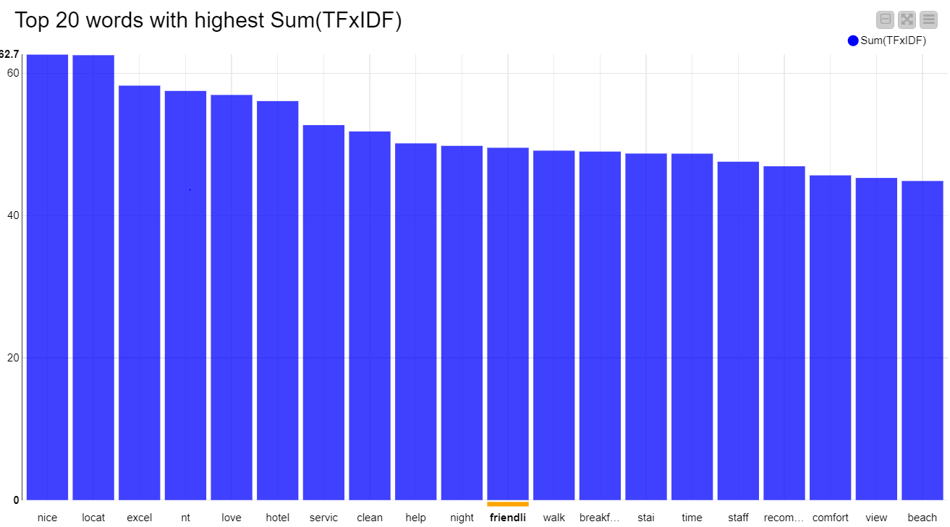
Positive Words with Highest Sum TF-IDF Frequency Measure
Location
Service
Clean
Help
Friendly
Walk
Breakfast
Staff
View
Beach

Slide 16
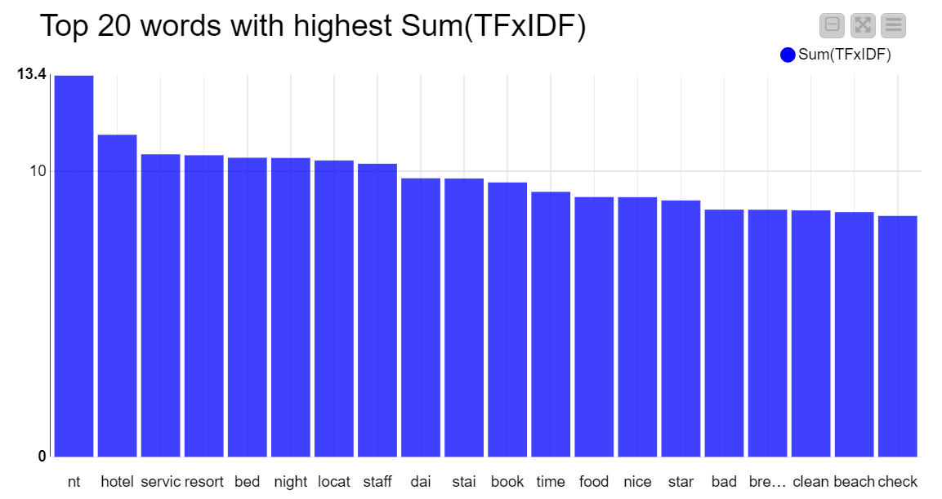
Negative Words with Highest Sum TF-IDF Frequency Measure
Service
Bed
Night
Location
Staff
Food
Bad
Breakfast
Clean
Beach

Slide 17
Python Overview
Python was used to do a Sentiment Analysis on the dataset.
Sentiment labels were added to transform this into a semi-supervised learning technique
As the data spread was imbalanced, this rather turned out to be challenging analysis

Slide 18
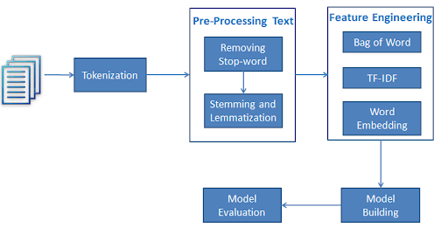
Python Flowchart

Slide 19
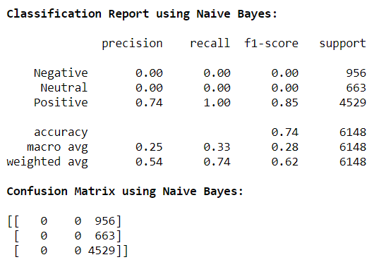
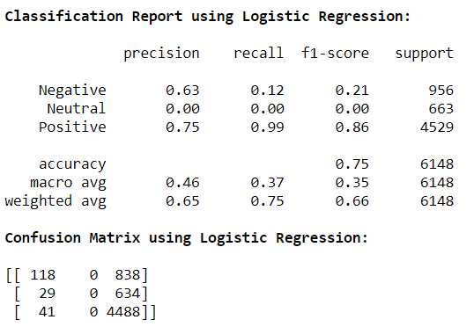
Python Overview (with Default Hyperparameters)
Multinomial Naïve Bayes and Logistic Regression was used to train the model and none of them could give the accuracy we were looking for

Slide 20
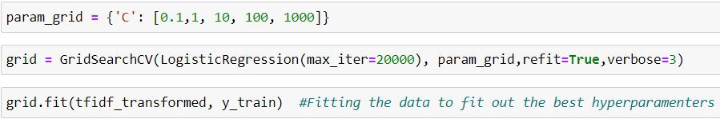
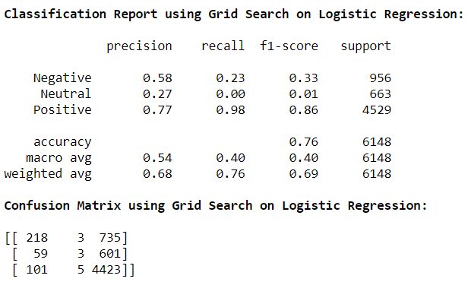
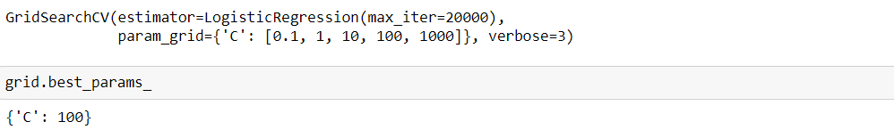
Python Overview (Model Enhancement)
Grid Search CV was then used to find the best cross validation fold for our training dataset
These techniques kept improving the model’s F1-score

Slide 21
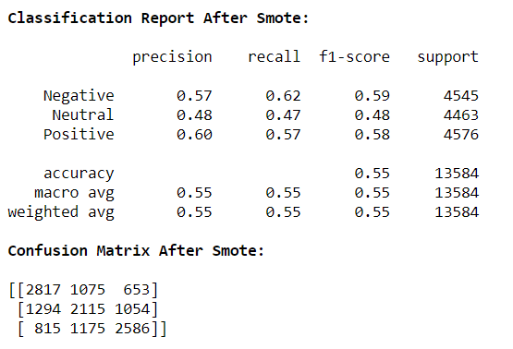


Performance Enhancement using SMOTE
SMOTE: A Python library to handle data imbalance by data oversampling was applied
This gave a better F1-score among all sentiments

Slide 22
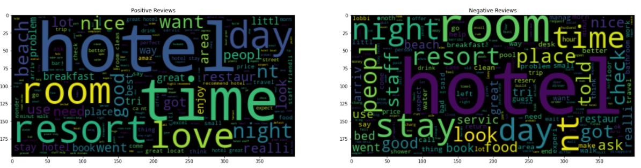
Outcome
Using trigrams and TFIDF algorithms we were able to find out which features contribute to a hotel’s Positive or Negative Review.
Positive and Negative review word clouds had similar words showing that a word cloud is not an effective measure in identifying positive and negative features

Slide 23
Lessons Learned
Dataset should be normally distributed to be able to build an effective model for Sentiment Analysis because a skewed data might hamper the performance and accuracy of the classification algorithm
To find trends you need context of the words. A single word frequency does not indicate a positive or a negative attribute.
A trigram can facilitate in finding such contexts

Slide 24
Questions

Slide 25
References
Ady, M. (2015, September 30). TrustYou study with ACCORHOTELS SHOWS effect of TripAdvisor reviews on bookings. Retrieved February 21, 2021, from https://www.hotel-online.com/press_releases/release/trustyou-study-with-accorhotels-shows-effect-of-tripadvisor-reviews-on-book/
Kinstler, L. (2018, August 17). How TripAdvisor changed travel. Retrieved February 21, 2021, from https://www.theguardian.com/news/2018/aug/17/how-tripadvisor-changed-travel
Péladeau, P., & Jelensperger, B. (2019, November 02). The 2019 tripadvisor and TheFork economic impact study. Retrieved February 21, 2021, from https://www.tripadvisor.com/ForRestaurants/r8927
Kaggle dataset: https://www.kaggle.com/andrewmvd/trip-advisor-hotel-reviews/tasks?taskId=2271

Slide 26
Thank you

